Slide 1
Test 1

Slide 2
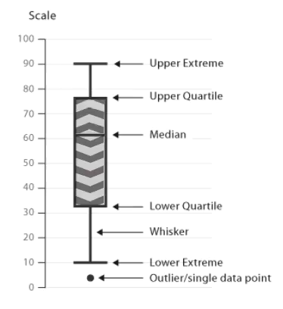
Boxplot
Up
Down
Arrow -> Increase from Median (‘Up’) or Decrease from Median (‘Down’)
Arrow’s Speed -> Distribution Compactness of ‘Up’ or ‘Down’

Slide 3

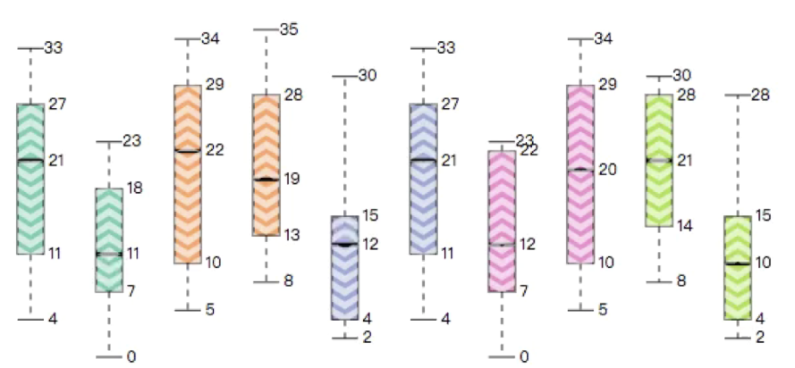
visualizing the age distribution of people in 10 groups ...
Color -> Country
Age
Female
Male
Female
Male
Group 10
Group1
Group2

Slide 4
Question 1-1
Which group has the most compact ‘Up’ OR ‘Down’ age distribution? and which one has the least?

Slide 5
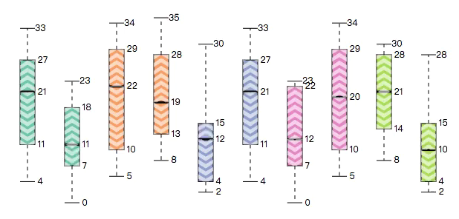
1
2
3
4
5
6
7
8
9
10
Question 1-1
Which group has the most compact ‘Up’ OR ‘Down’ age distribution? and which one has the least?

Slide 6
Question 1-2
Is the ‘Up’ age distribution in group 3 more compact than that of group 6?

Slide 7
3
6
Question 1-2
Is the ‘Up’ age distribution in group 3 more compact than that of group 6?

Slide 8
Question 1-3
Sort the ‘Down’ of the 4 highlighted groups from most compact
to least compact

Slide 9
2
7
9
10
Question 1-3
Sort the ‘Down’ of the 4 highlighted groups from most compact to least compact

Slide 10
Test 2

Slide 11
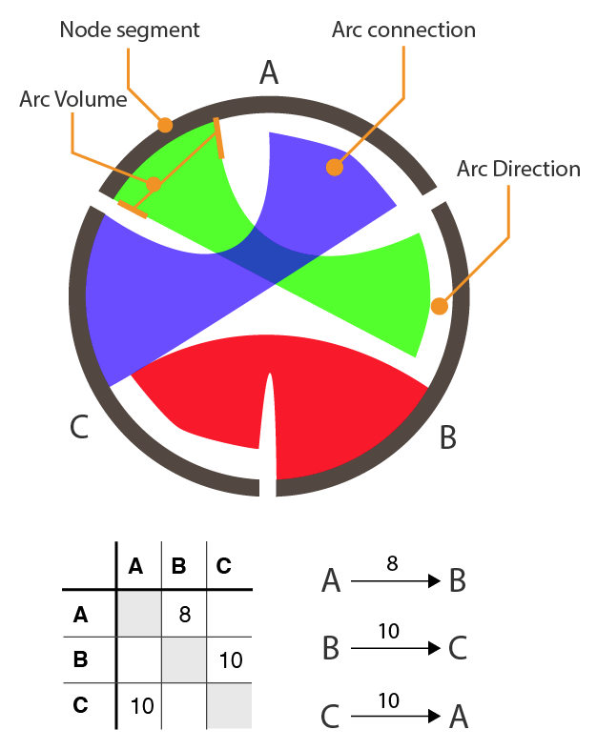
Circos

Slide 12
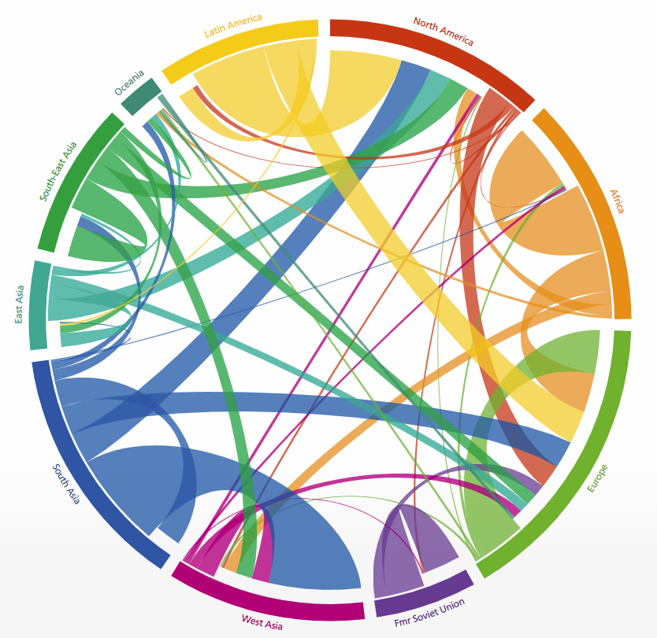
visualizing the immigration between regions…
Region 1
Stripe’s Width
-> Immigration Population
Region 2

Slide 13
Question 2-1
Locate the largest immigration

Slide 14
Latin America
North America
Oceania
South-East Asia
Africa
East Asia
South Asia
Europe
West Asia
Fmr Soviet Union
Question 2-1
Locate the largest immigration

Slide 15
Question 2-2
Which immigration to North America gets the largest population, from South-east Asia or East Asia?

Slide 16
Latin America
North America
Oceania
South-East Asia
Africa
East Asia
South Asia
Europe
West Asia
Fmr Soviet Union
Question 2-2
Which immigration to North America gets the largest population, from South-east Asia or East Asia?

Slide 17
Question 2-3
Sort the top 4 immigrations from South Asia in increasing population order

Slide 18
Latin America
North America
Oceania
South-East Asia
Africa
East Asia
South Asia
Europe
West Asia
Fmr Soviet Union
Question 2-3
Sort the top 4 immigrations from South Asia in increasing population order

Slide 19
Test 3

Slide 20
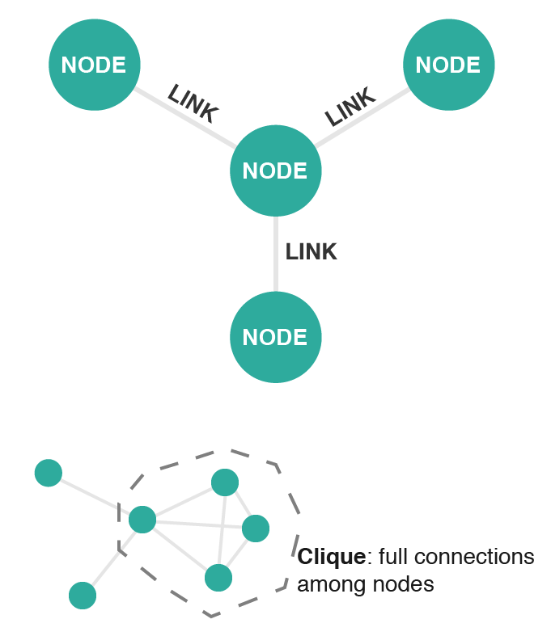
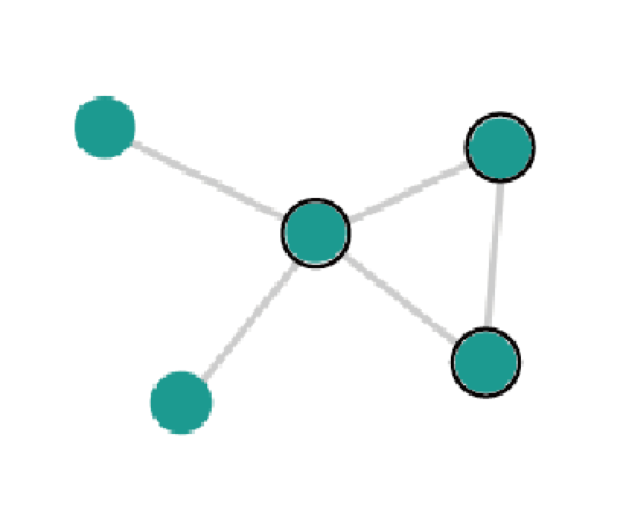
Graph
Same Color with Black Frame -> Clique
Expanding Area -> Clique Size (number of nodes in the clique)

Slide 21
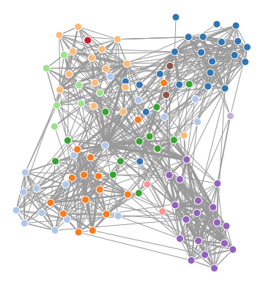
visualizing a social network between people in different countries…
Node -> People
Color -> Country
Link -> Social connection

Slide 22
Question 3-1
Which country gets the largest clique?

Slide 23
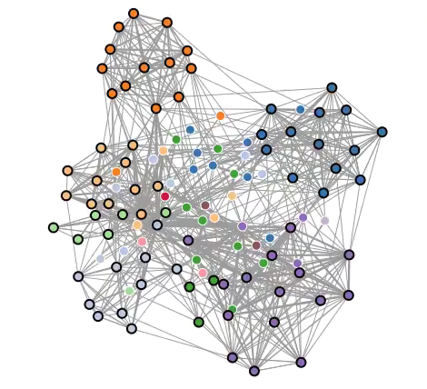
Question 3-1
Which country gets the largest clique?

Slide 24
Question 3-2
Does the dark orange country have a larger clique than that of the dark blue country?

Slide 25
Question 3-2
Does the dark orange country have a larger clique than that of the dark blue country?

Slide 26
Question 3-3
Sort the countries in increasing clique size order
(order does not matter when the size is equal)

Slide 27
Question 3-3
Sort the countries in increasing clique size order (order does not matter when the size is equal)

Slide 28
Want a Break?

Slide 29
Test 4

Slide 30
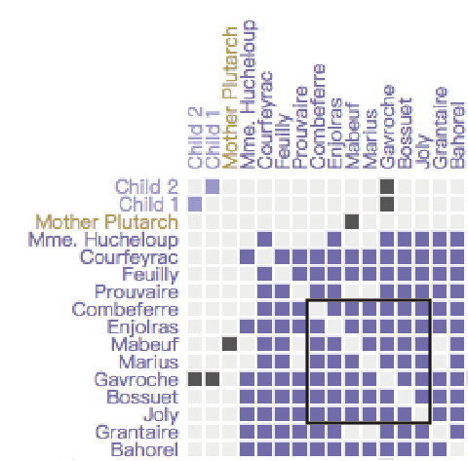
Connection from “Child1” to “Child2”
Matrix
Clique: full connection among nodes
Cells with Black Frame -> Clique
Stroke Width -> Clique Size (number of nodes in the clique)
small
large

Slide 31
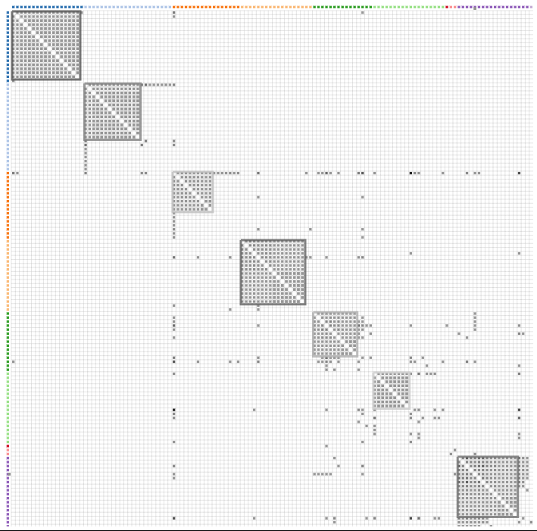
visualizing a social network between people in different countries…
Node -> People
Color -> Country
Gray cell -> Social connection
Blank cell -> No social connection

Slide 32
Question 4-1
Which clique is the largest?

Slide 33
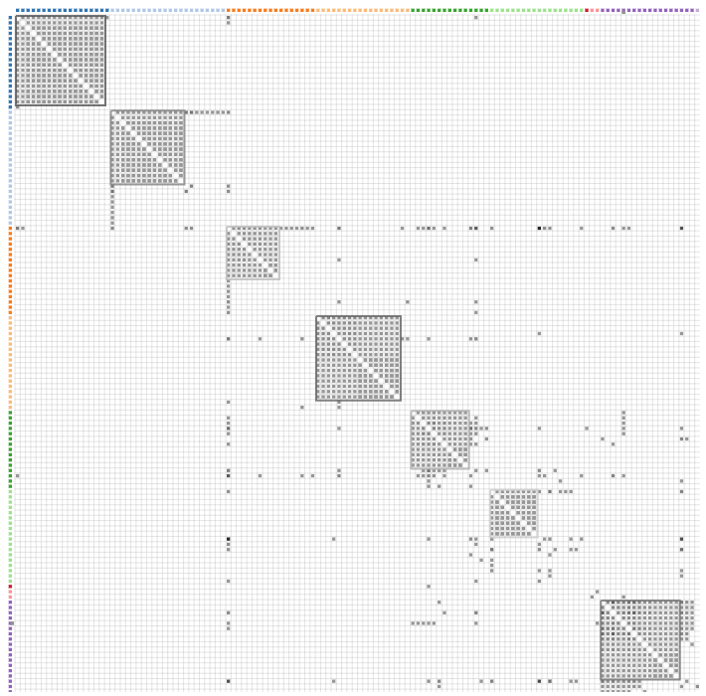
1
2
3
4
5
6
7
Question 4-1
Which clique is the largest?

Slide 34
Question 4-2
Which clique has a larger number of nodes, 3 or 5?

Slide 35
3
5
Question 4-2
Which clique has a larger number of nodes, 3 or 5?

Slide 36
Question 4-3
Sort all cliques in ascending order

Slide 37
1
2
3
4
5
6
7
Question 4-3
Sort all cliques in ascending size order

Slide 38
Test 5

Slide 39
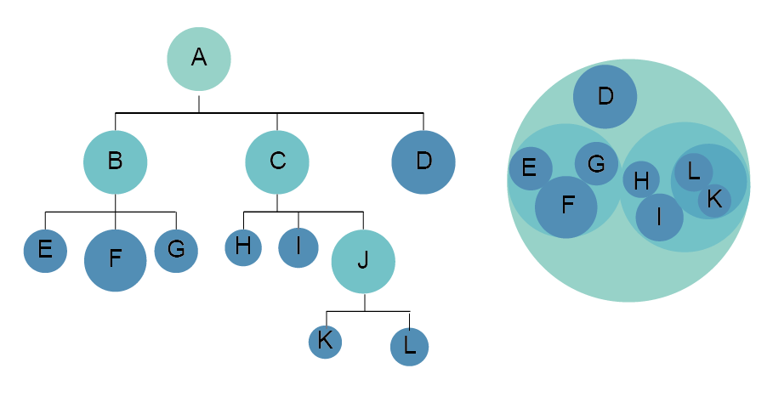
D
Circle Packing
D
1. Flickering of the dashed border -> Traversal over the leaves according to depth

Slide 40
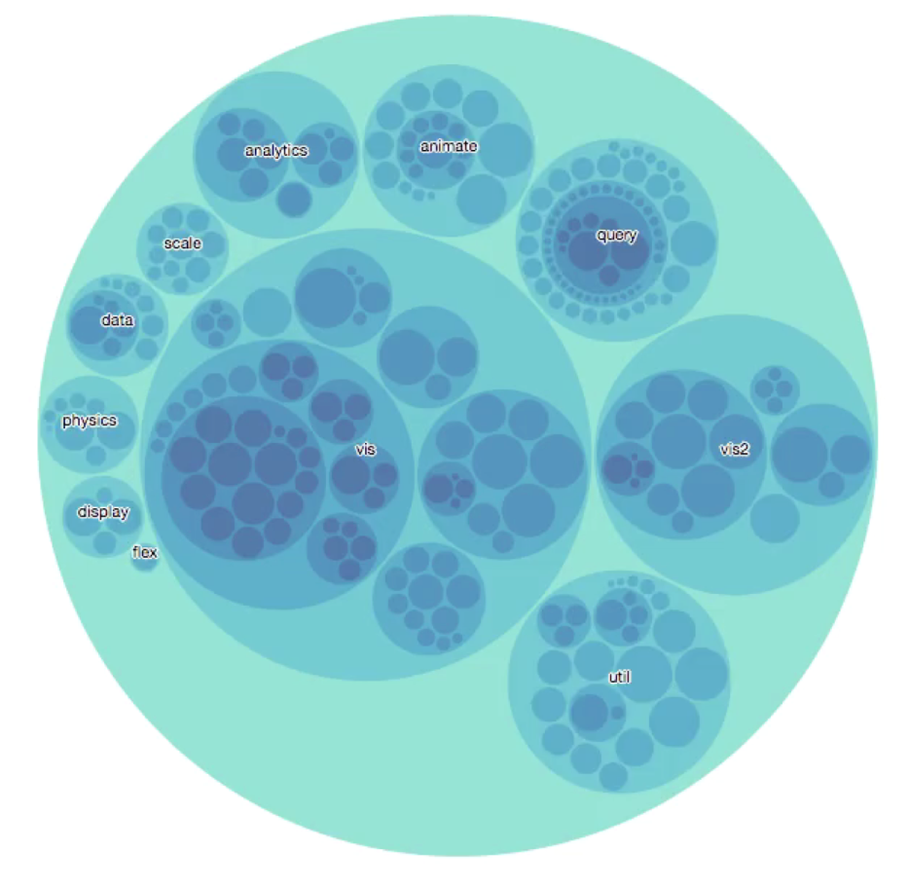
visualizing a hierarchy structure of topics in academic field…
Circle -> Topic
Size -> Prevalence

Slide 41
Question 5-1
Does the sub-tree ‘util’ contain any node in the deepest level?

Slide 42
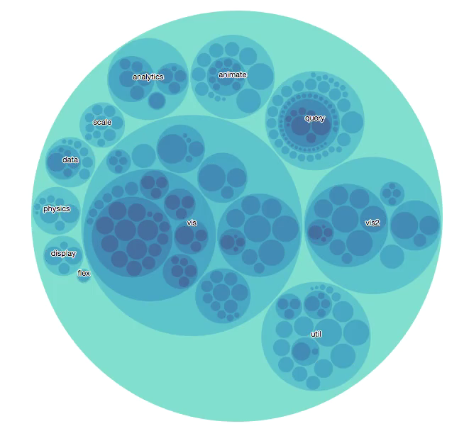
Util
Question 5-1
Does the sub-tree ‘util’ contain any node in the deepest level?

Slide 43
Question 5-2
Is the sub-tree ‘data’ deeper than the subtree ‘util’ ?

Slide 44
data
util
Question 5-2
Is the sub-tree ‘data’ deeper than the subtree ‘util’ ?

Slide 45
Question 5-3
Sort the subtrees ‘analytics’, ‘data’ and ‘query’ in increasing depth order
(order doesn’t matter when the depth is equal)

Slide 46
analytics
query
data
Sort the subtrees ‘analytics’, ‘data’ and ‘query’ in increasing depth order
(order doesn’t matter when the depth is equal)
Question 5-3

Slide 47
Test 6

Slide 48
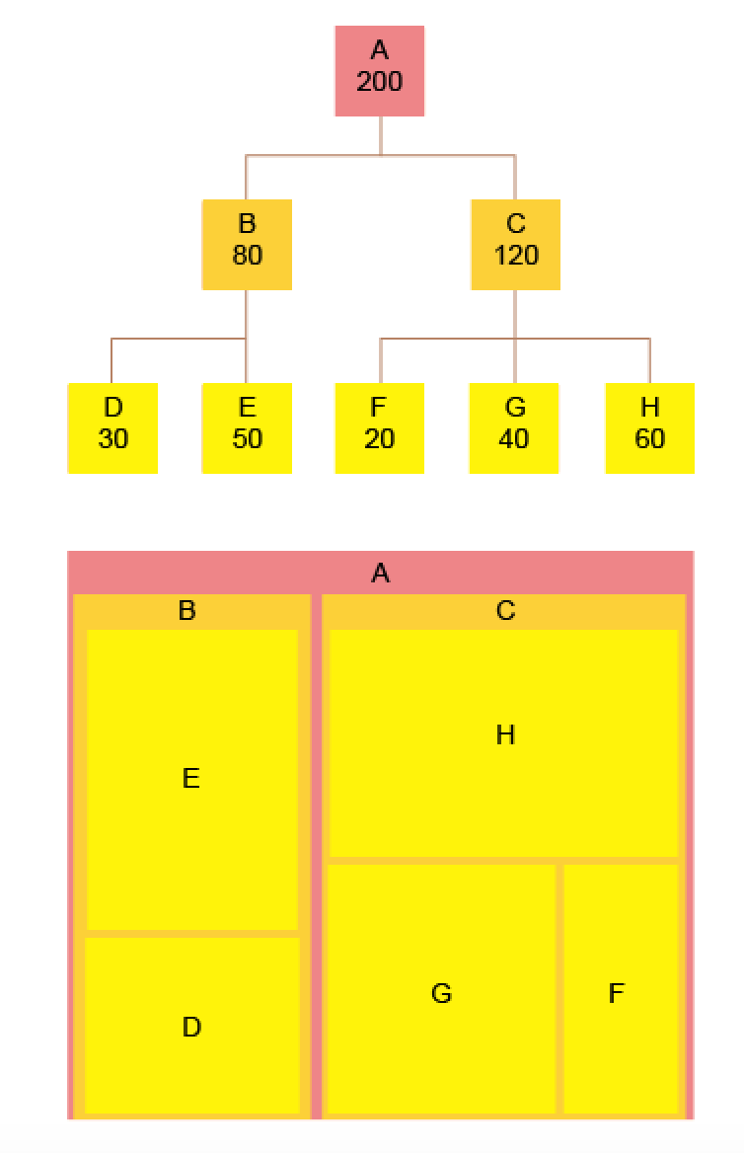
Treemap
Hue -> Level
Level 1
Level 2
Level 3

Slide 49
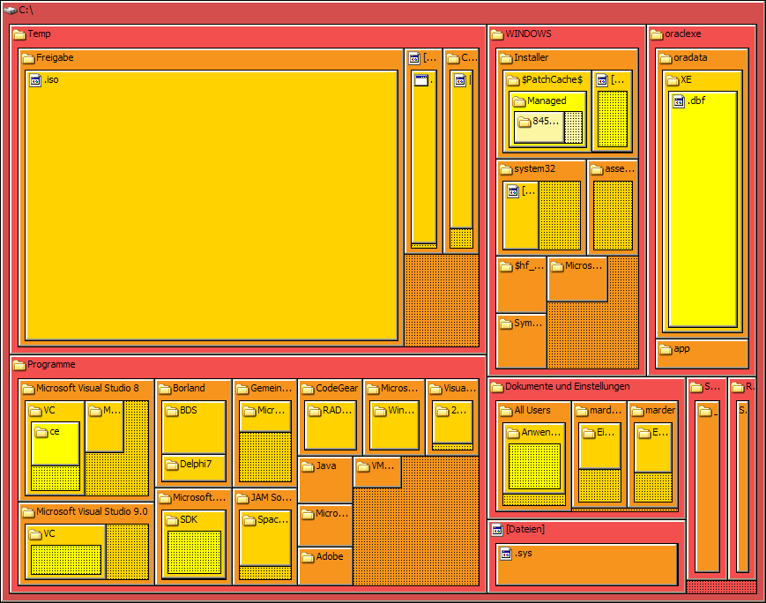
visualizing a folder structure of “C:” disk…

Slide 50
Question 6-1
Which folder in “C:” is the deepest?

Slide 51
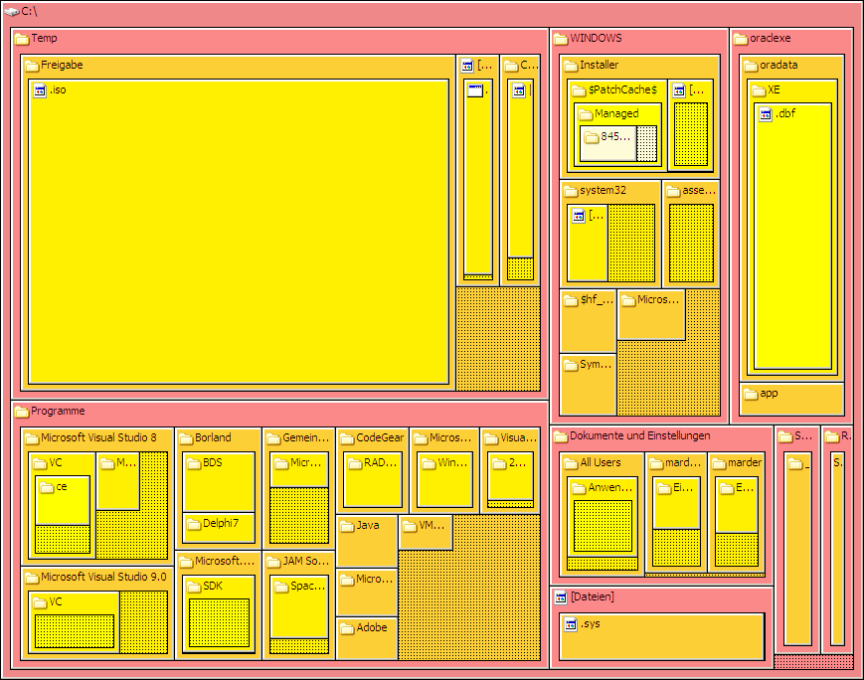
C:\
Question 6-1
Which folder in “C:” is the deepest?

Slide 52
Question 6-2
Which folder has more direct subfolders, “Temp” or “Windows”? (The two in left-top)

Slide 53
Windows
Temp
Question 6-1
Which folder has more direct subfolders, “Temp” or “Windows”? (The two in left-top)

Slide 54
Question 6-3
Sort the folders “Temp”, “Windows”, and “Programme” in increasing depth order

Slide 55
Windows
Temp
Programme
Question 6-3
Sort the folders “Temp”, “Windows”, and “Programme” in increasing depth order

Slide 56
Finished! Thank you : )

